Slide 1


Slide 2



Participants :
MD. EMRAN NAZIR EFTY
22-47802-2
SYED MUSAEED HOSSAIN
20-42437-1
Faculty :
MD. NAZMUL HOSSAIN

Slide 3

Get Started
Contribution
Exit

Slide 4
Admin Login
Email:
Password:
Forgot Password?
Show Password
Sign In
New Here? Register
Back
Exit

Slide 5

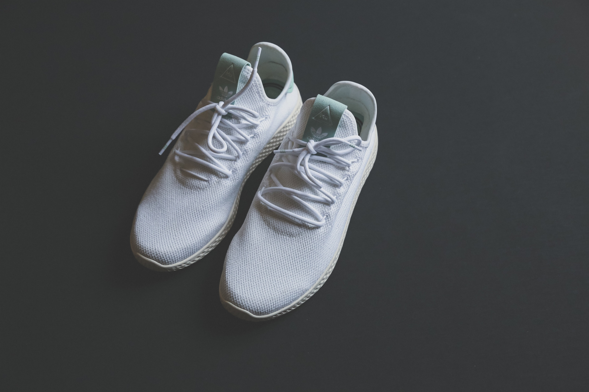
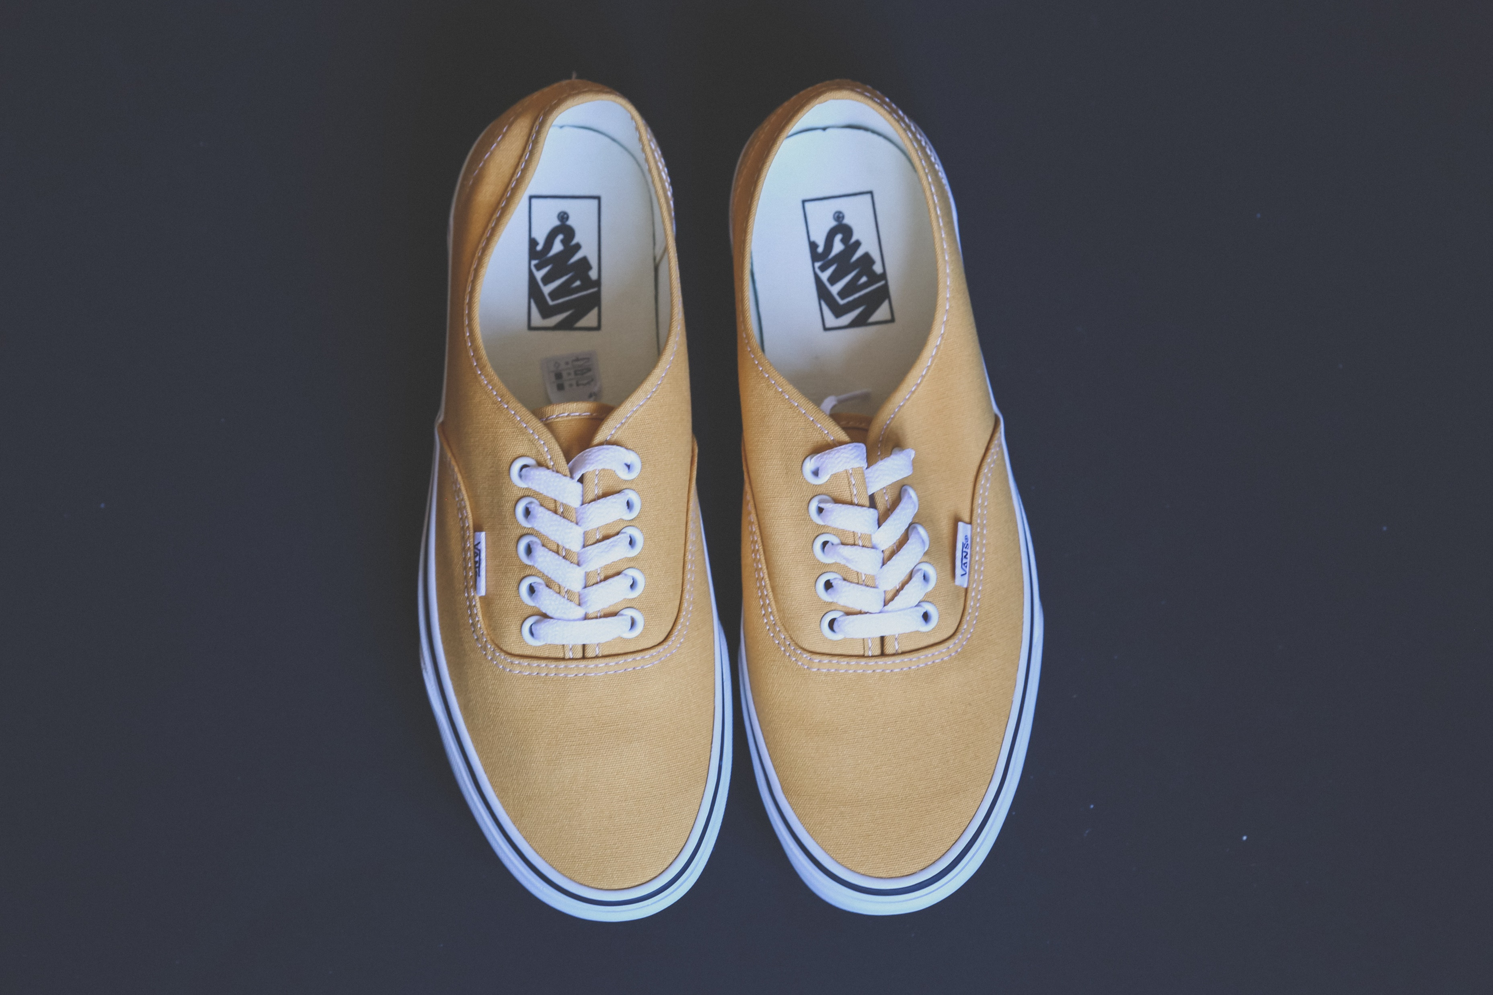
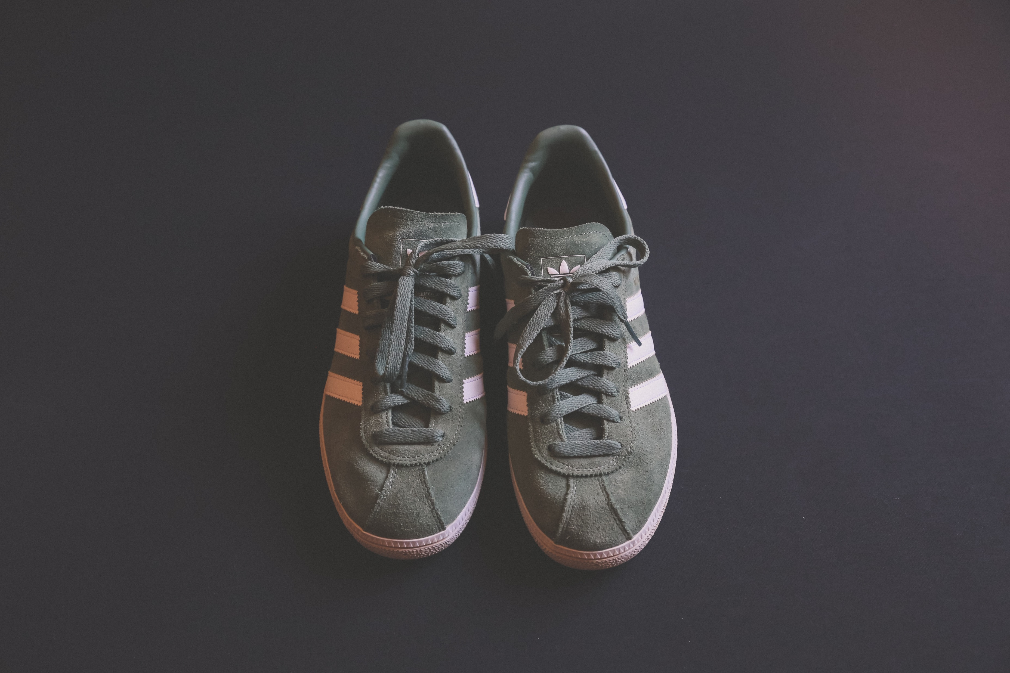
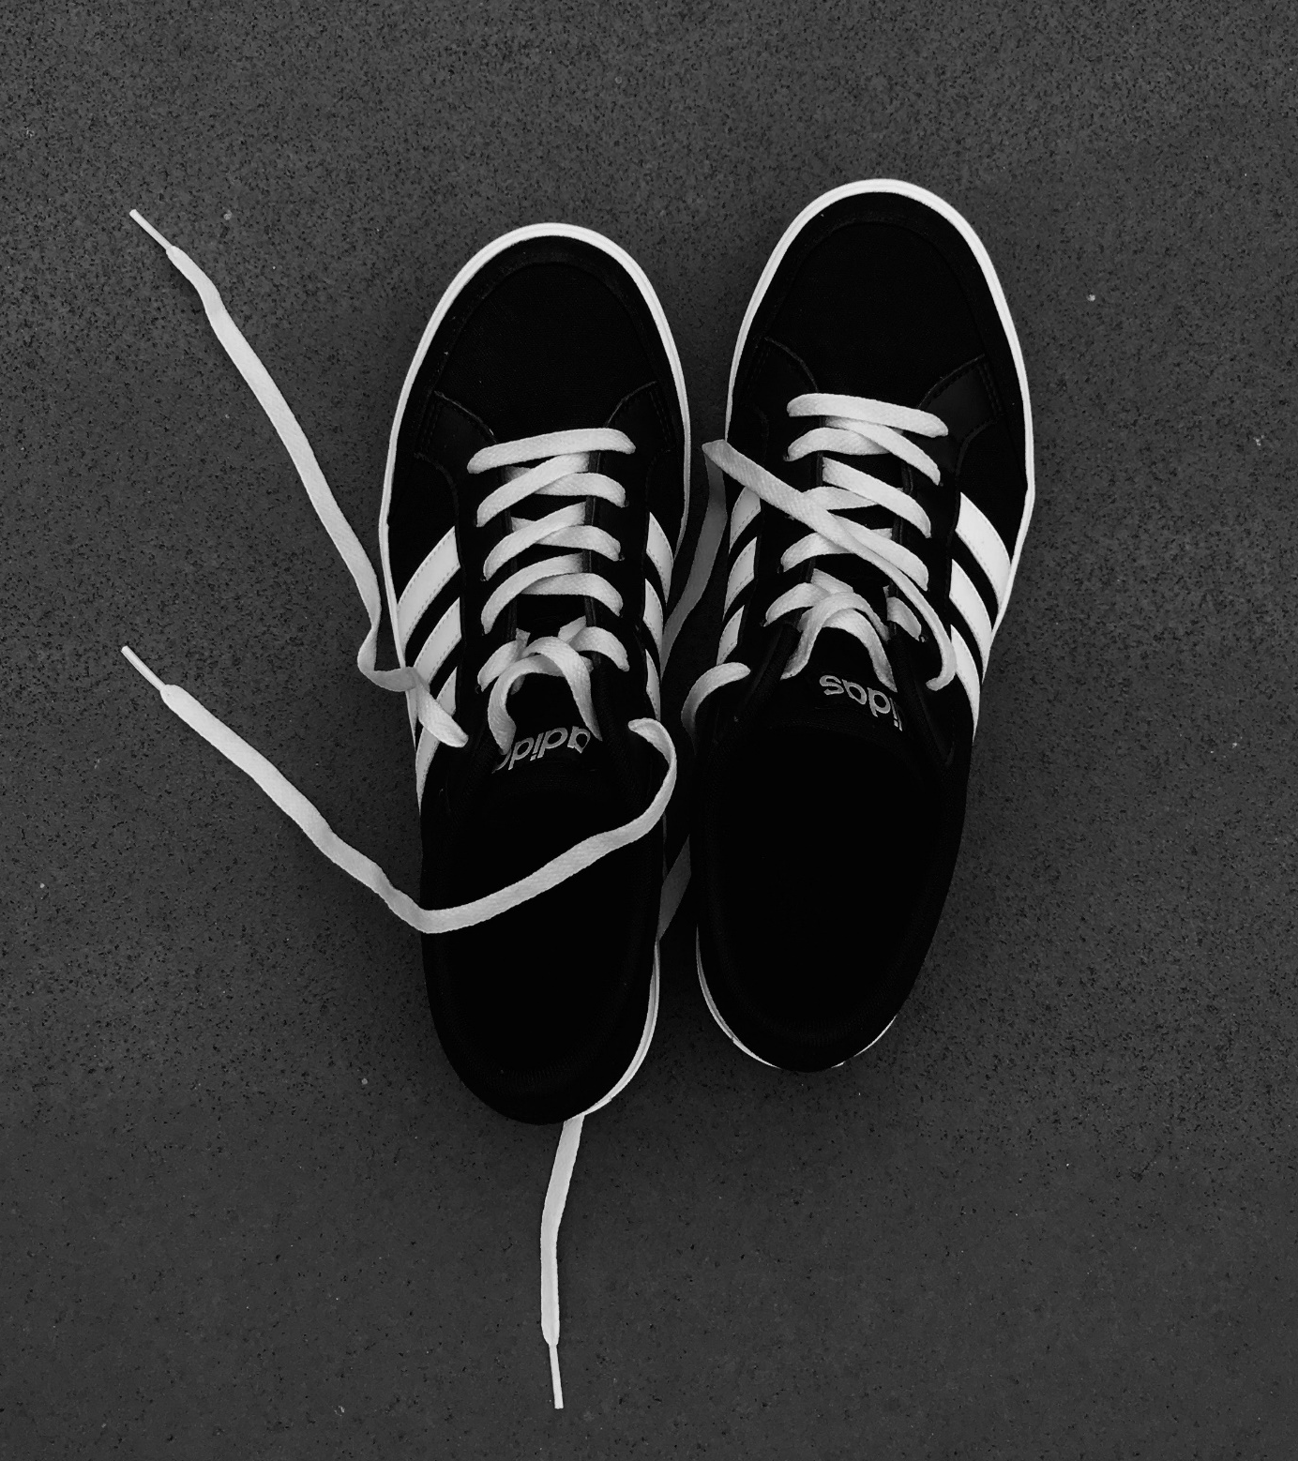





JORASHOES
Men
Women
Kids
Offers
Login/Register
Bag
Black Men
White Men
Brown Men
Gray Men
Blsck Men
Price: 2,200
Price: 2,100
Price: 2,950
Price: 2,100
Contact Us
J O R A S H O E S
01989854945
01679228352
©
2022 JORASHOES | All Right Reserved

Slide 6
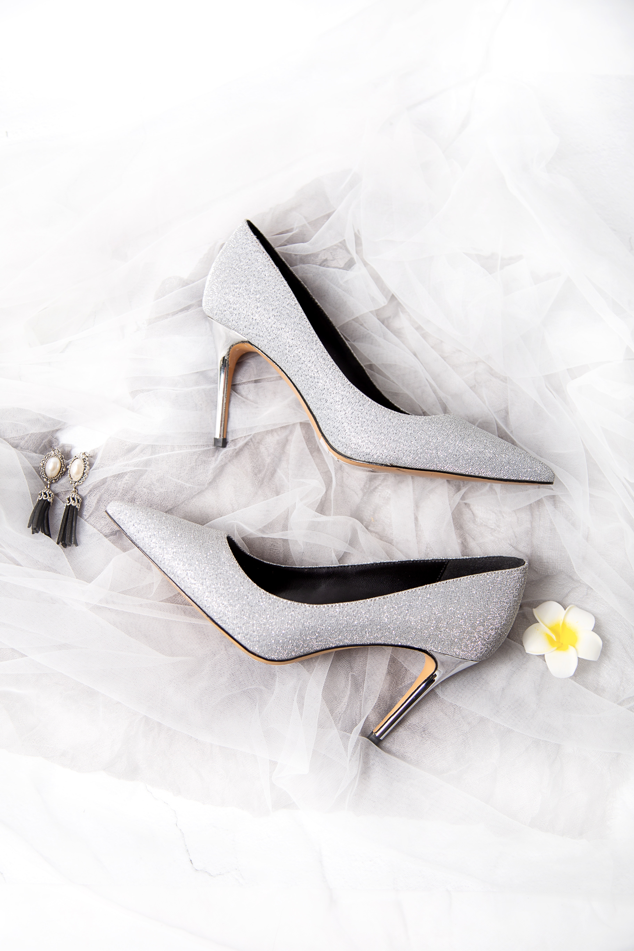
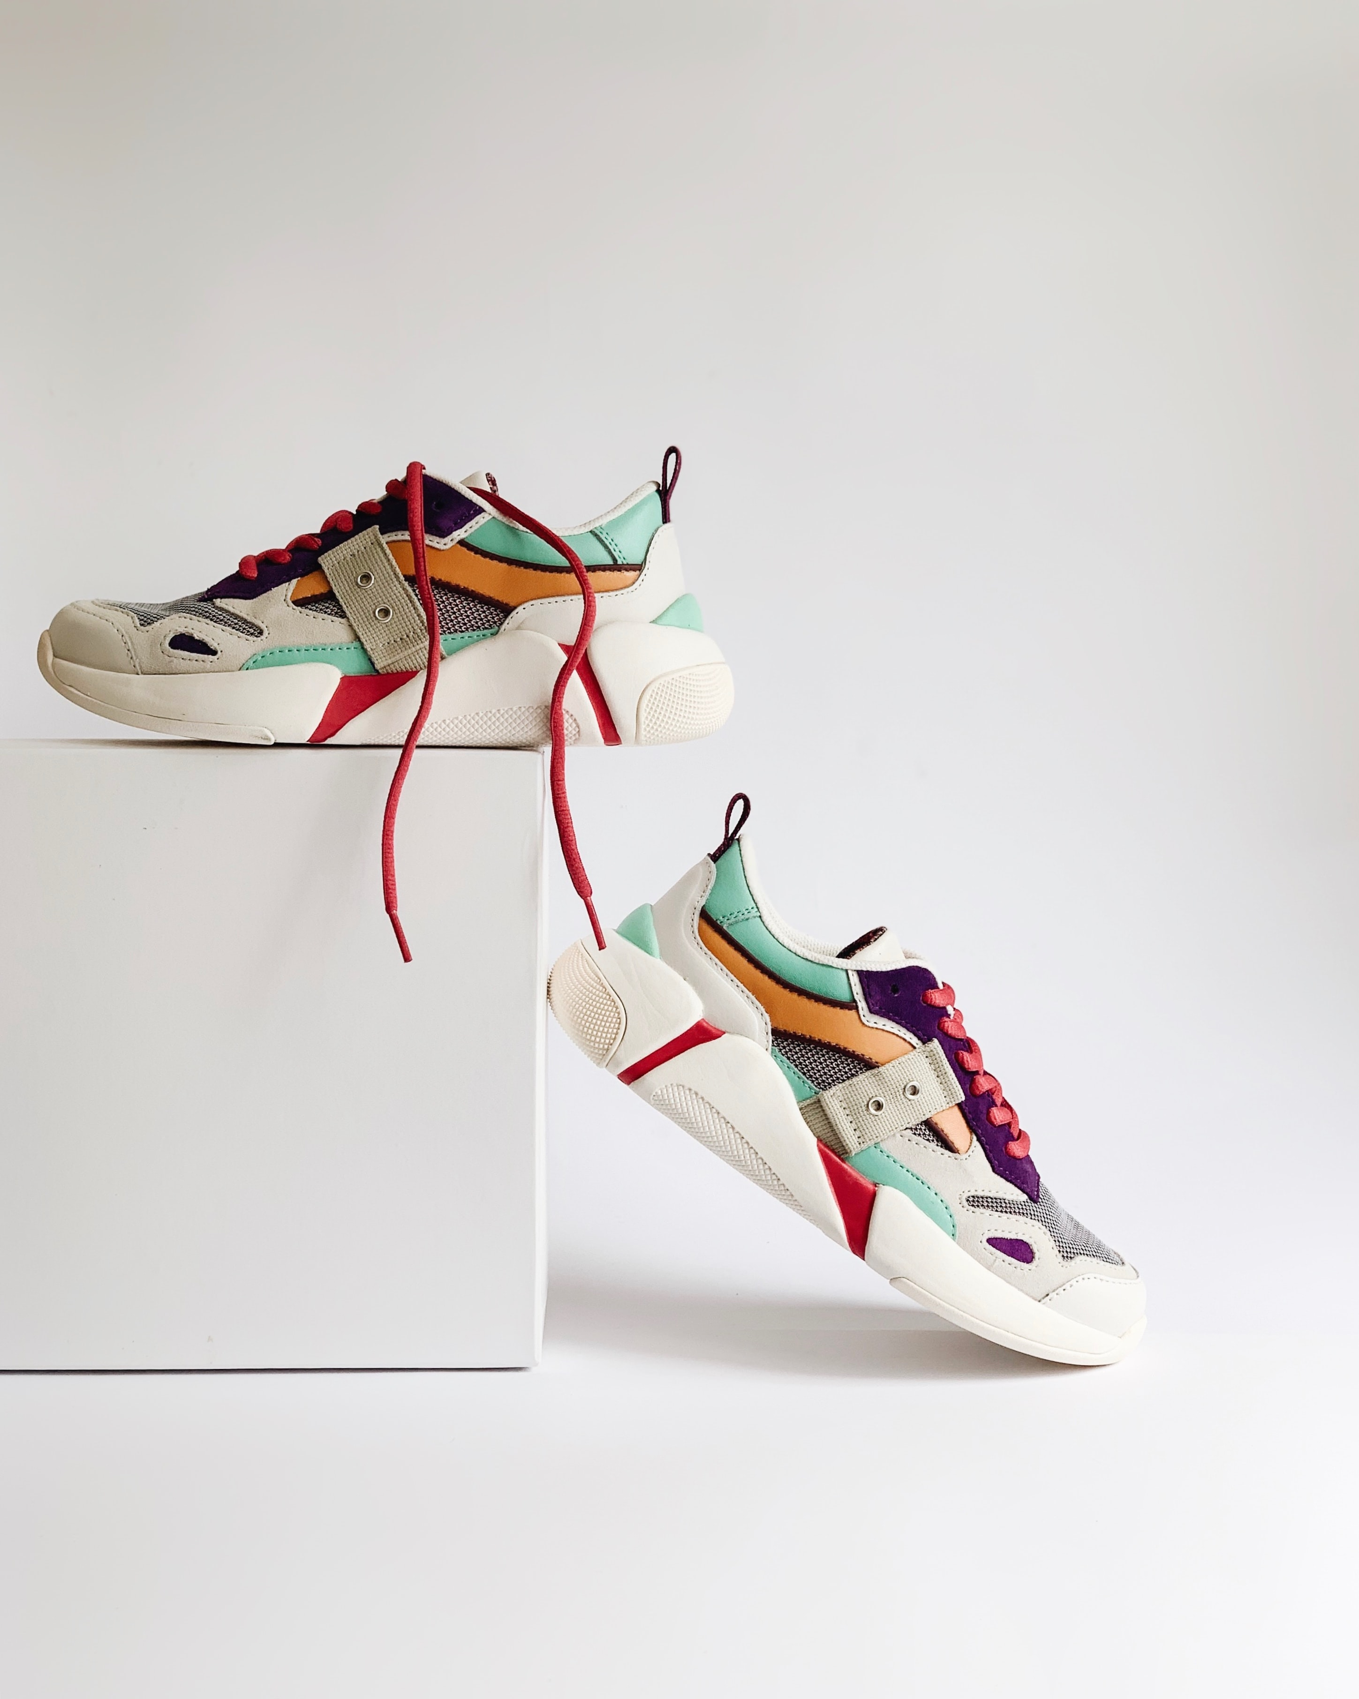
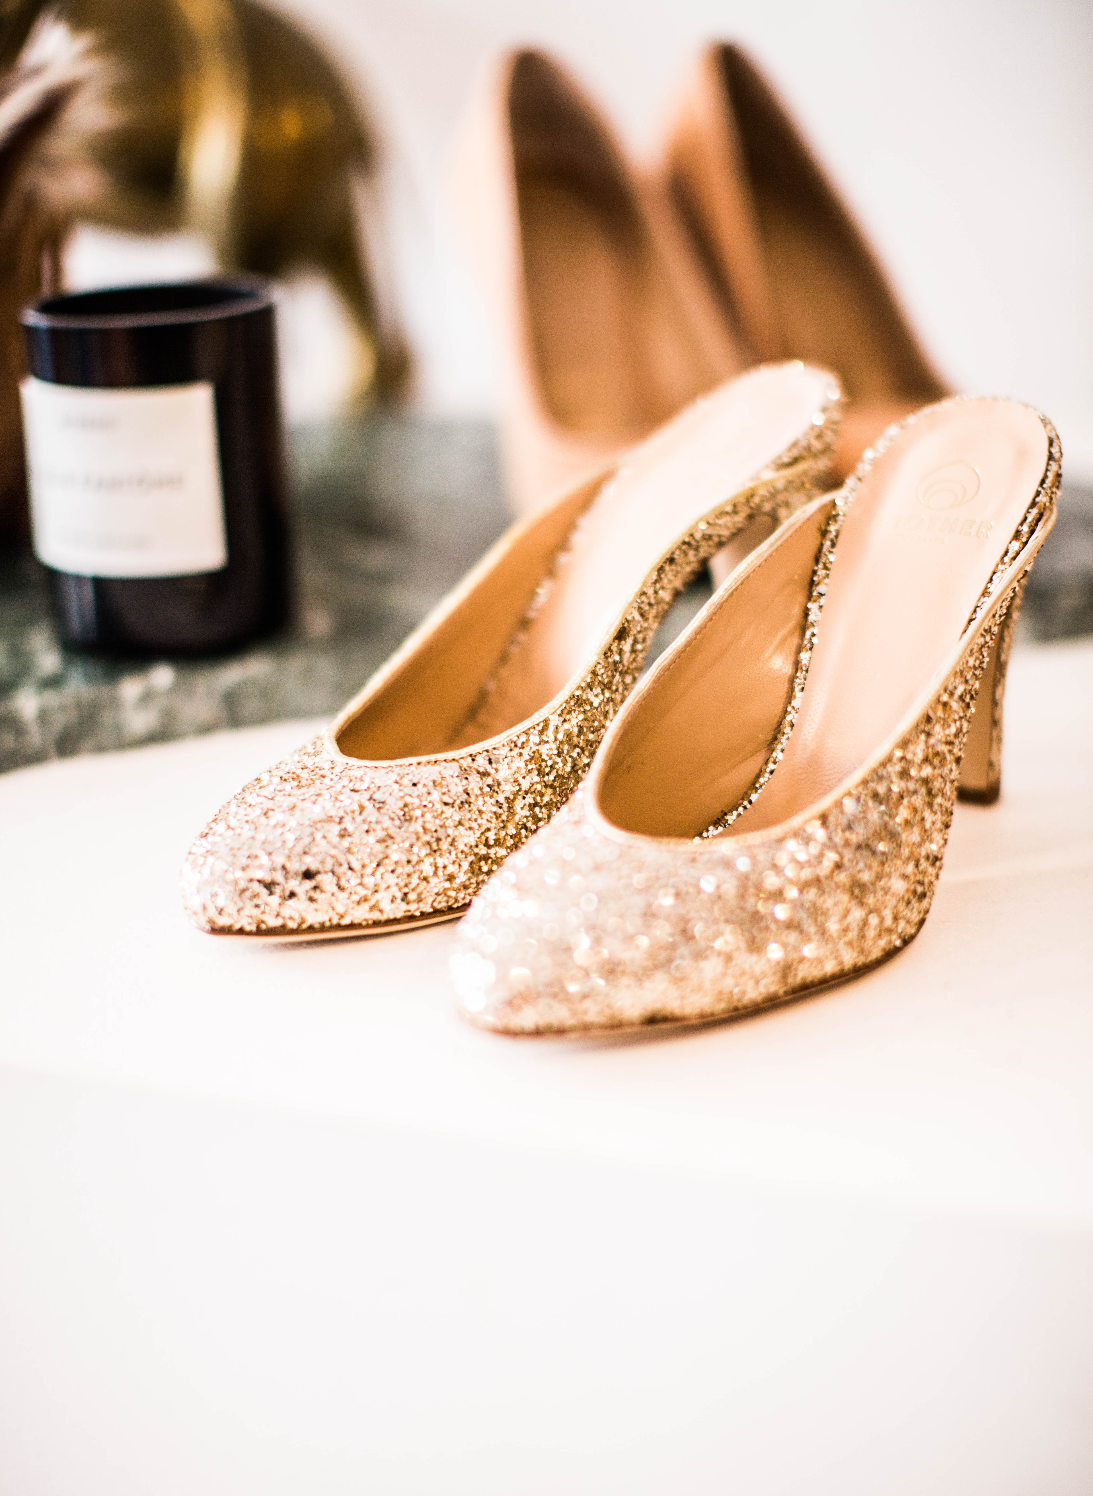
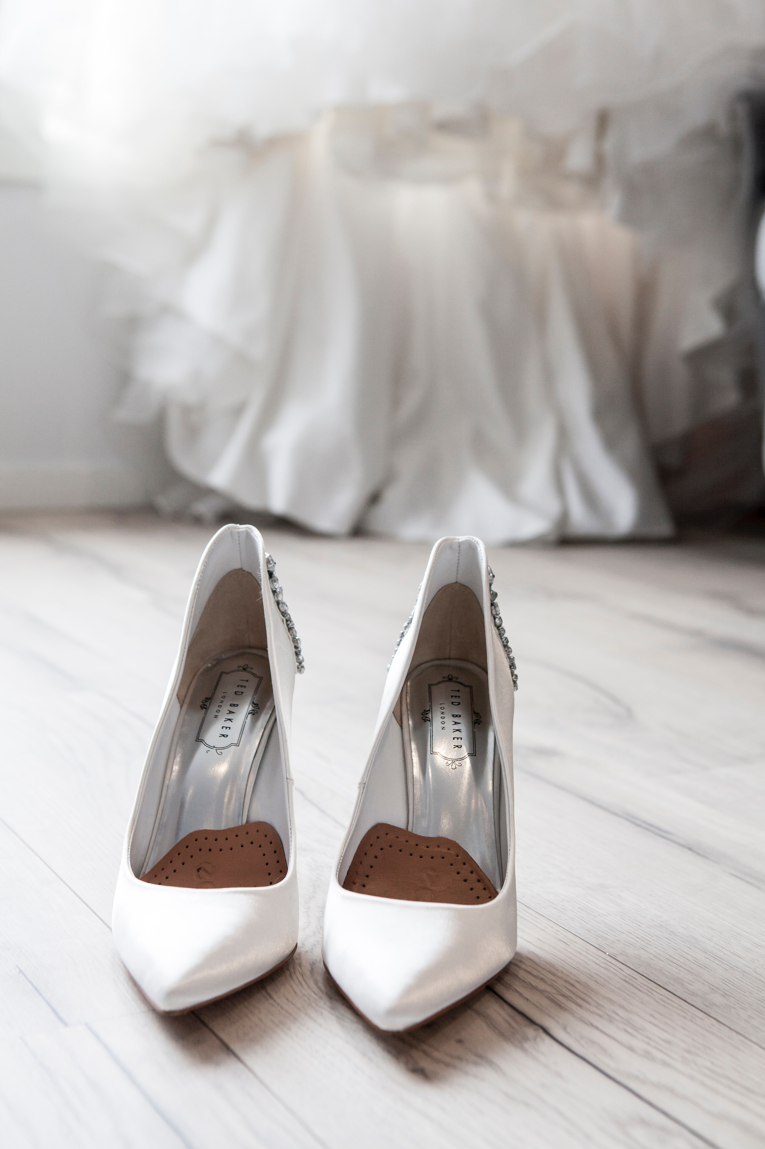
JORASHOES
Men
Women
Kids
Offers
Login/Register
Bag
Women
Black Men
White Heels
X Sneakers
Golden Star
Brown Men
Price: 2,500
Price: 2,000
Price: 3,000
Price: 2,700
Contact Us
J O R A S H O E S
01989854945
01679228352
©
2022 JORASHOES | All Right Reserved

Slide 7
JORASHOES
Men
Women
Kids
Offers
Login/Register
Bag
Men
Black Men
White Men
Brown Men
Gray Men
Brown Men
Price: 2,200
Price: 2,100
Price: 2,950
Price: 2,100
Contact Us
J O R A S H O E S
01989854945
01679228352
©
2022 JORASHOES | All Right Reserved

Slide 8
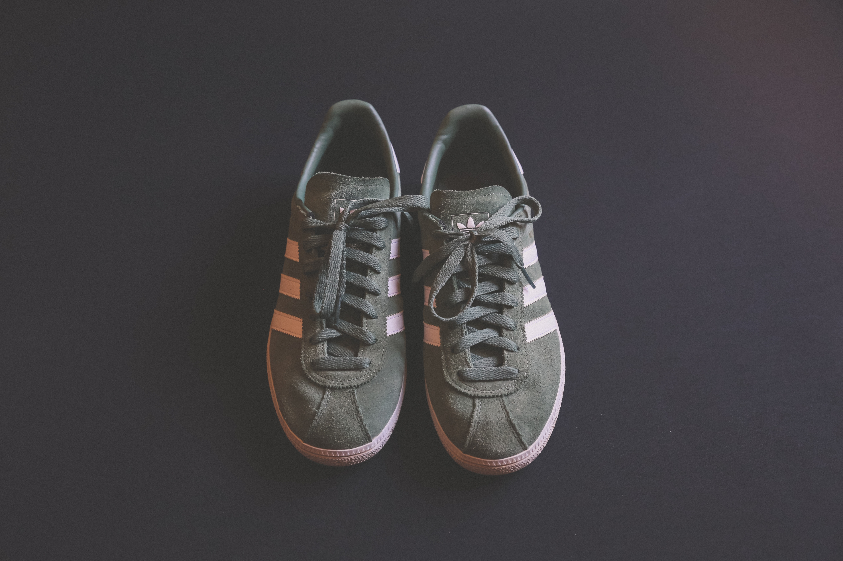
JORASHOES
Men
Women
Kids
Offers
Login/Register
Bag
Catagory : Men
Size Available :
Name : Grey Men
22
23
24
25
Colour Available :
Gray Green Only
Price :
2,950 /=
BUY NOW
ADD TO BAG
Contact Us
J O R A S H O E S
01989854945
01679228352
©
2022 JORASHOES | All Right Reserved

Slide 9
JORASHOES
Men
Women
Kids
Offers
Login/Register
Bag
Your Bag :
Grey Men
Size : 23
Quantity : 1
+
-
Colour : Gray Green
Total Price :
2,950 /=
DONE
ORDER

Slide 10
JORASHOES
Men
Women
Kids
Offers
Login/Register
Bag
Catagory : Men
Size Available :
Name : Grey Men
22
23
24
25
Colour Available :
Gray Green Only
Price :
1,950 /=
BUY NOW
ADD TO BAG
Contact Us
J O R A S H O E S
01989854945
01679228352
©
2022 JORASHOES | All Right Reserved

Slide 11
Sign In
Let’s Get Started
Email:
Password:
Show Password
Forgot Password?
Sign In
New Here? Signup
Admin Login
Back
Exit

Slide 12
Sign Up
Name:
Email:
Phone Number:
Address:
Password:
Signup
Reset
Back
Exit

Slide 13
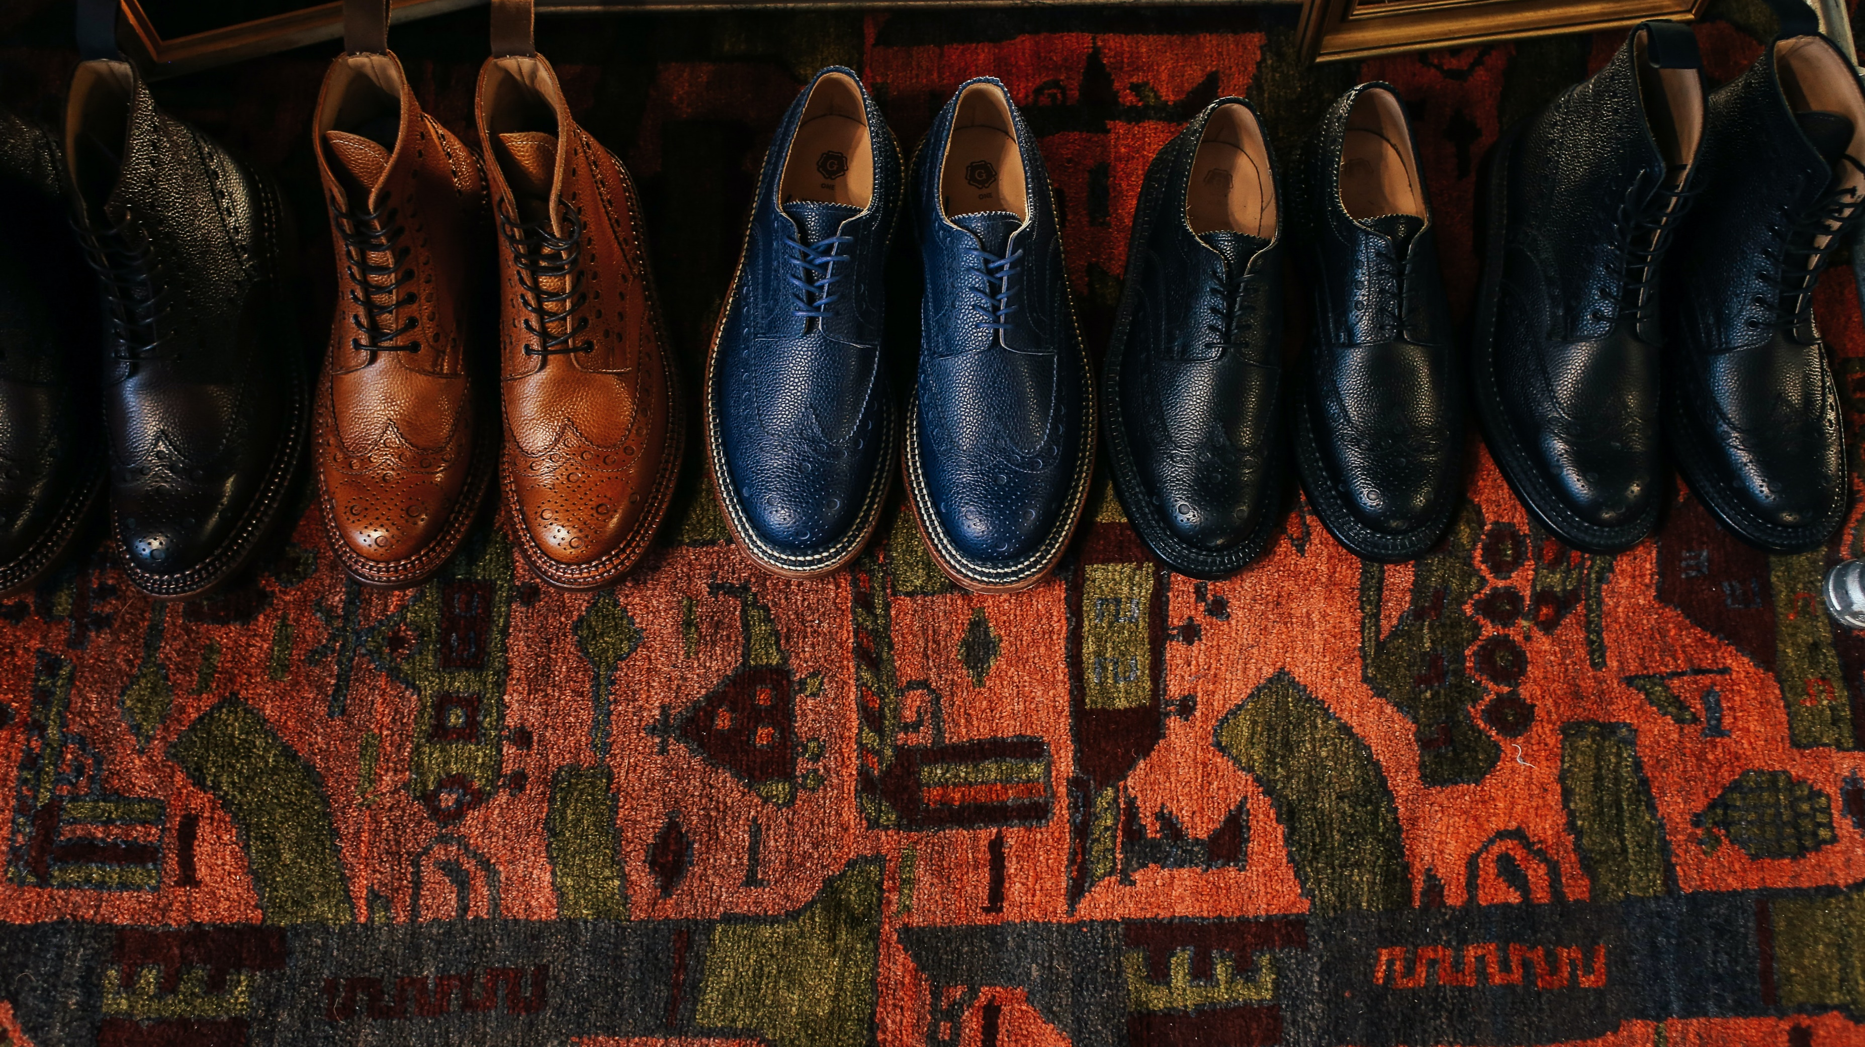
JORASHOES
Men
Women
Kids
Offers
Login/Register
Bag
Create Account Successful !!
Continue
©
2022 JORASHOES | All Right Reserved

Slide 14



JORASHOES
Men
Women
Kids
Offers
Login/Register
Bag
Total Ammount: 2,950/=
Choose Your Payment Method
Credit/Debit Card
Bkash
Cash On Delivery
©
2022 JORASHOES | All Right Reserved

Slide 15
JORASHOES
Men
Women
Kids
Offers
Login/Register
Bag
Bkash
Total Amount:
2,950/=
Credit/Debit Card
Enter Your Number:
Continue
©
2022 JORASHOES | All Right Reserved

Slide 16
JORASHOES
Men
Women
Kids
Offers
Login/Register
Bag
Thank You For Your Order!!
DONE
©
2022 JORASHOES | All Right Reserved

Slide 17
JORASHOES
Men
Women
Kids
Offers
Login/Register
Bag
Black Men
White Men
Brown Men
Gray Men
Brown Men
Price: 2,200
Price: 2,100
Price: 2,950
Price: 2,100
Contact Us
J O R A S H O E S
01989854945
01679228352
©
2022 JORASHOES | All Right Reserved

Slide 18
JORASHOES
Men
Women
Kids
Offers
Login/Register
Bag
THE END
©
2022 JORASHOES | All Right Reserved

